Slide 1
AIM :To create a platform which establishes connection between job provider and job seeker
SOLUTION :By creating a fully functional web application/mobile app
PRESENTED BY:TEAM CREATORS

Slide 2
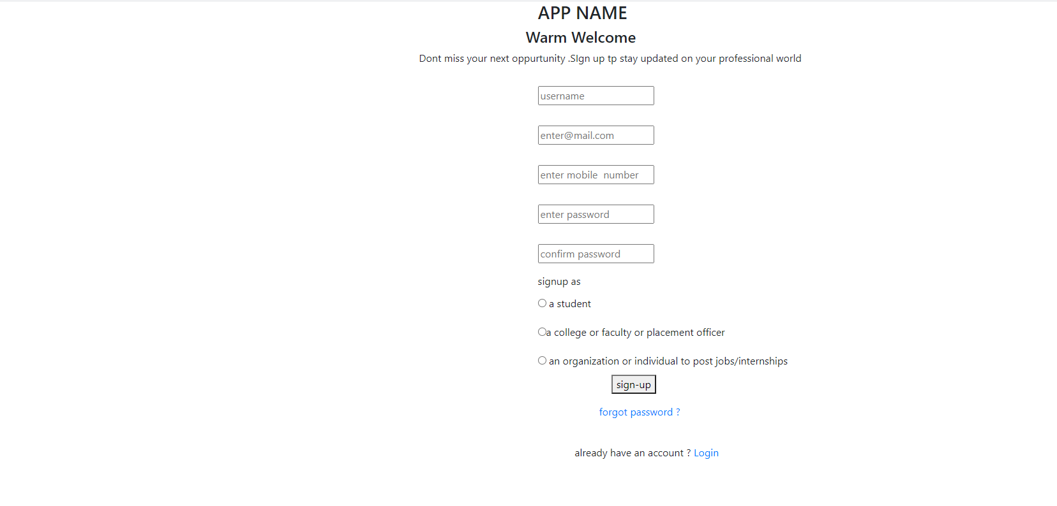
SIGNUP PAGE:

Slide 3
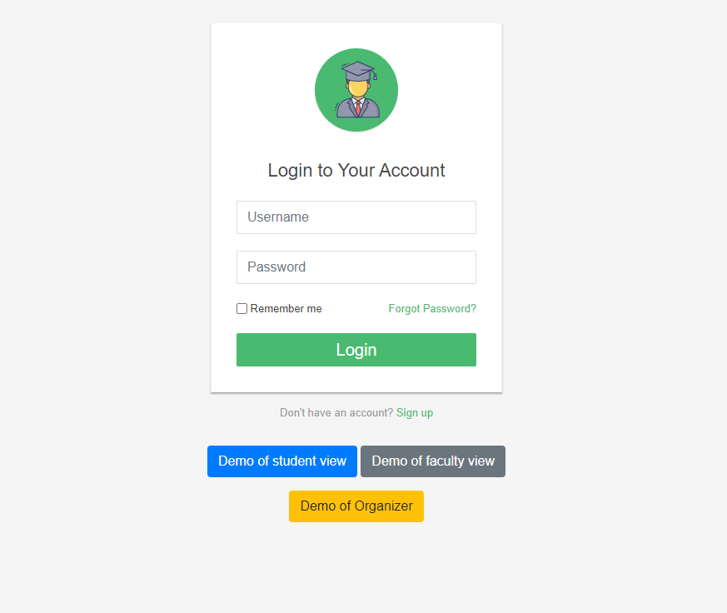
LOGIN PAGE
3 different views for 3 different users
1)Students /job seekers
2)colleges(placement officers/faculty)
3)Organizations /individuals –for posting jobs ,internships

Slide 4
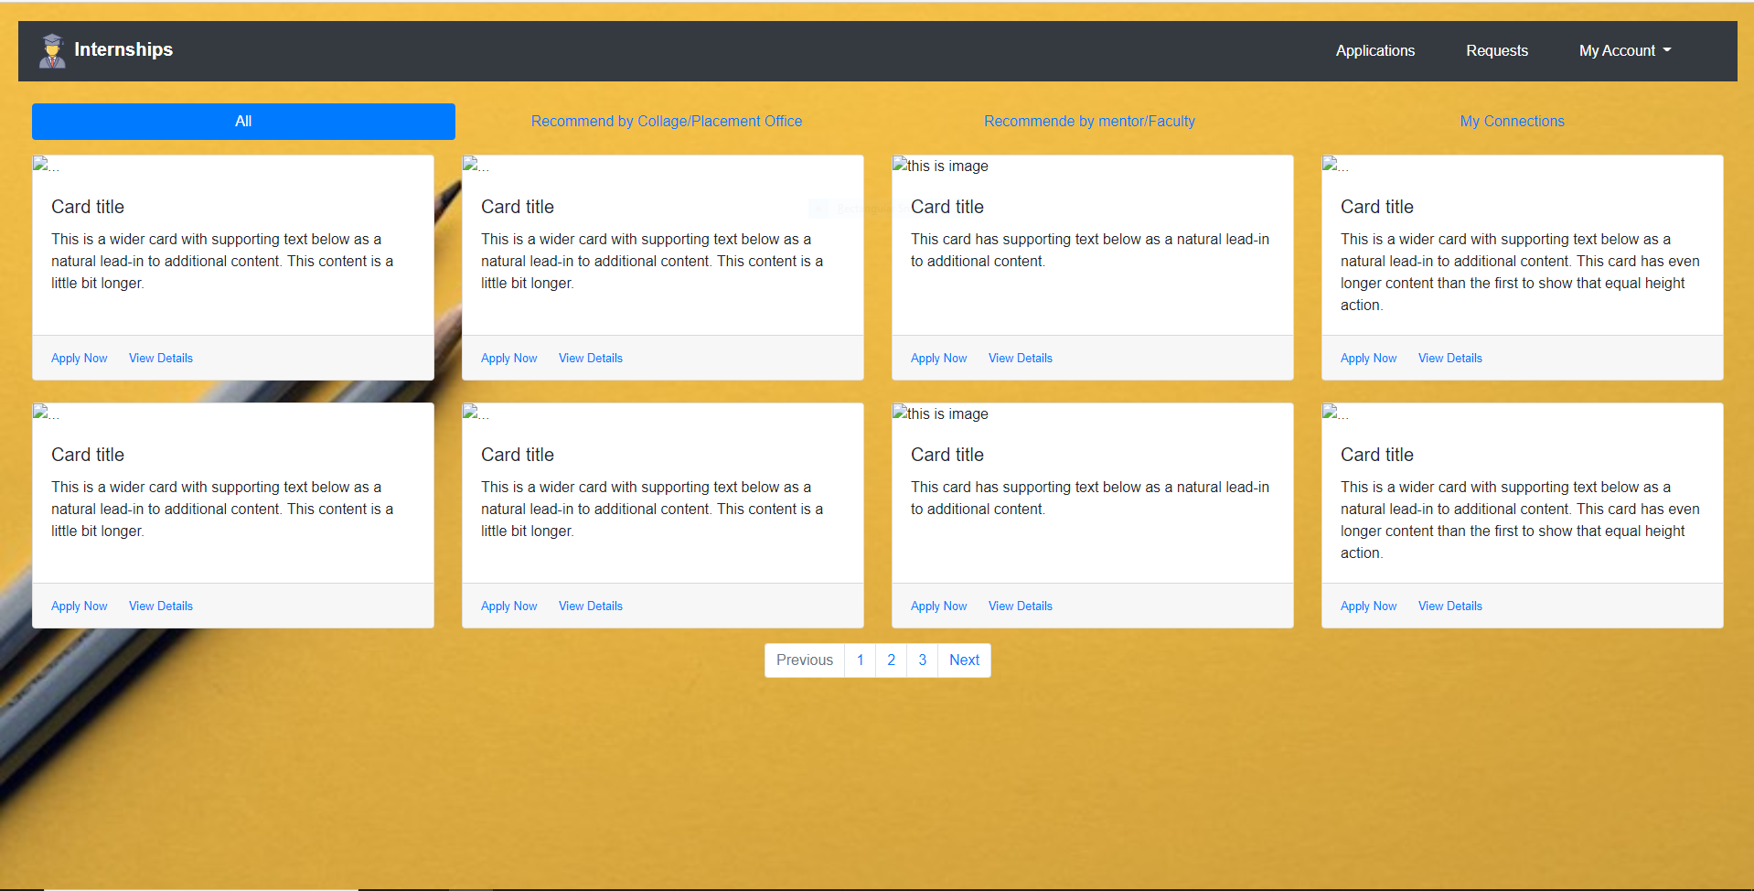
Student view :

Slide 5
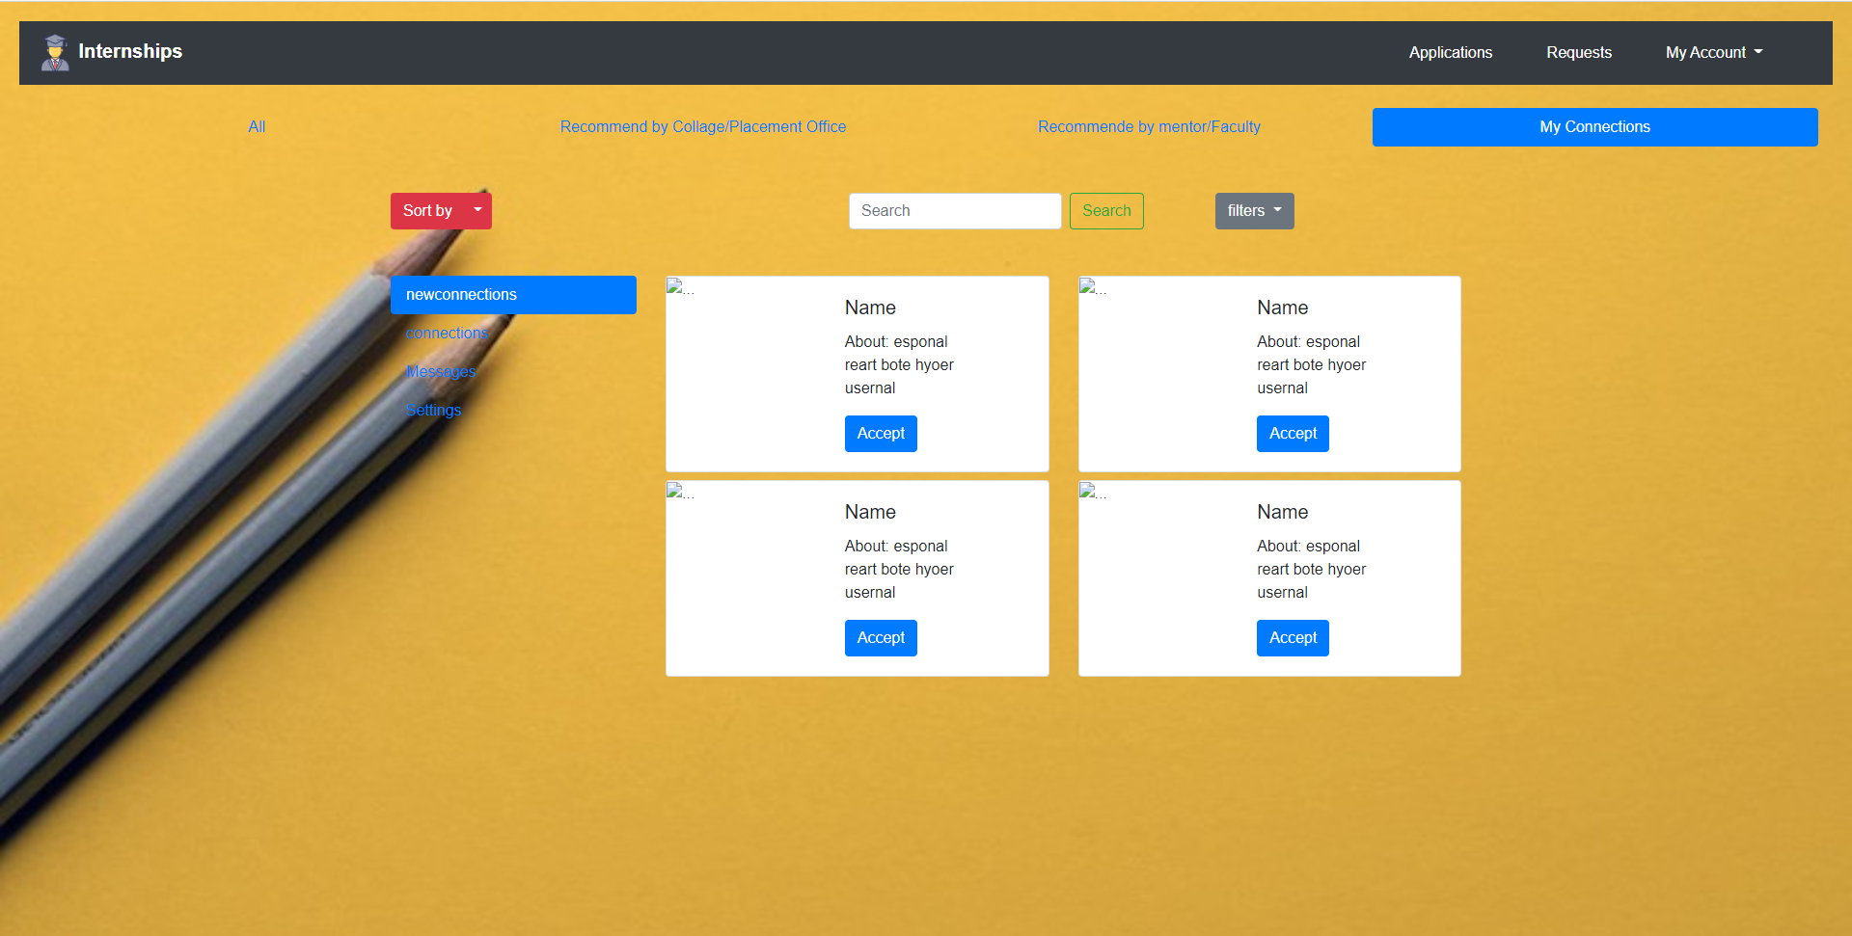
MY CONNECTIONS:

Slide 6
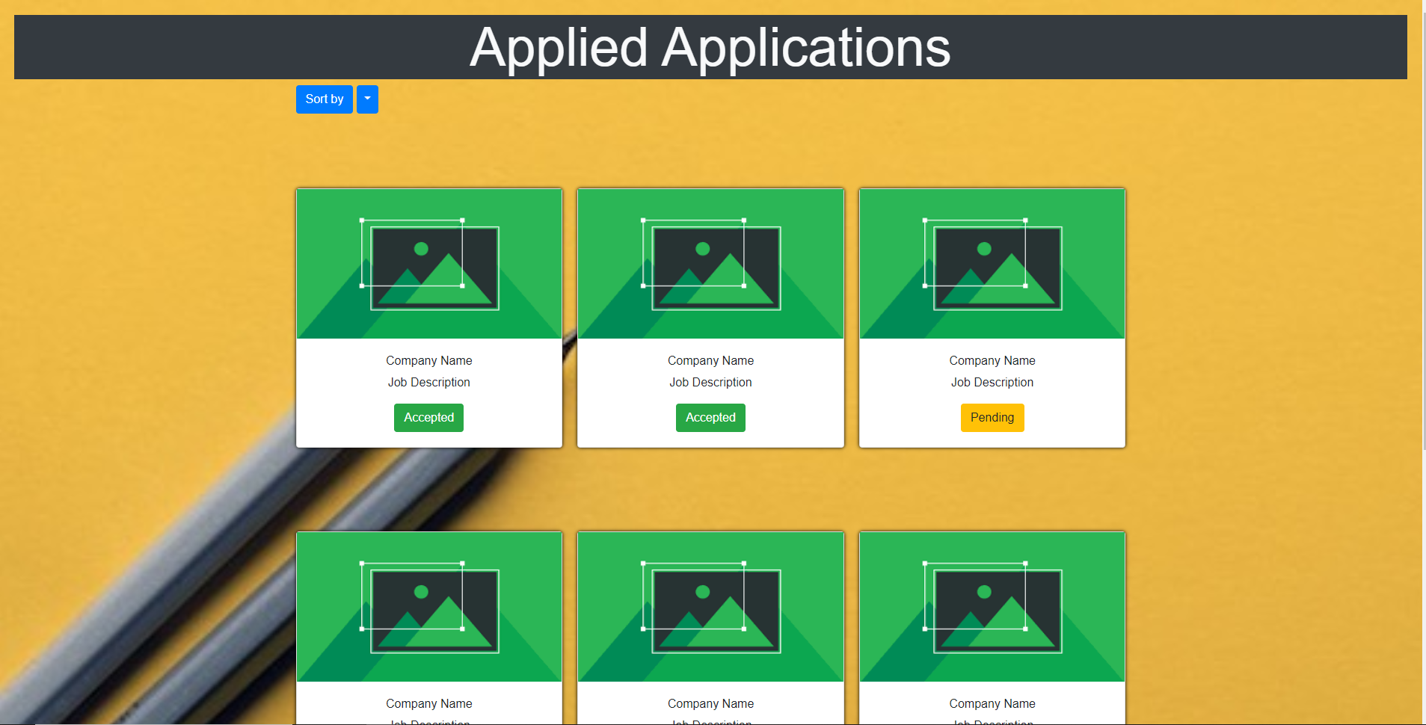
APPLICATIONS:

Slide 7
* MY CONNECTIONS : Place where all the connections (network) of student will be appeared. He can connect with organizations , placement officer and faculty of of respective college.
*APPLICATIONS : Place where he can all his applications and their status .
* JOBS : Where student will be able to see all the jobs/internships posted by various organizations.
*BY-COLLEGE : As student will be connected with respective college placement officer ,student will be able to see jobs/internships recommended by placement officer
* BY-FACULTY/MENTOR : As there will be a connection between a student and faculty, faculty can recommend the jobs/internships which suits the skills of students and those jobs/internships will be appear here.
BRIEF DESCRIPTION OF STUDENT VIEW

Slide 8

COLLEGE /INSTITUTION VIEW:

Slide 9

CONNECTIONS:

Slide 10
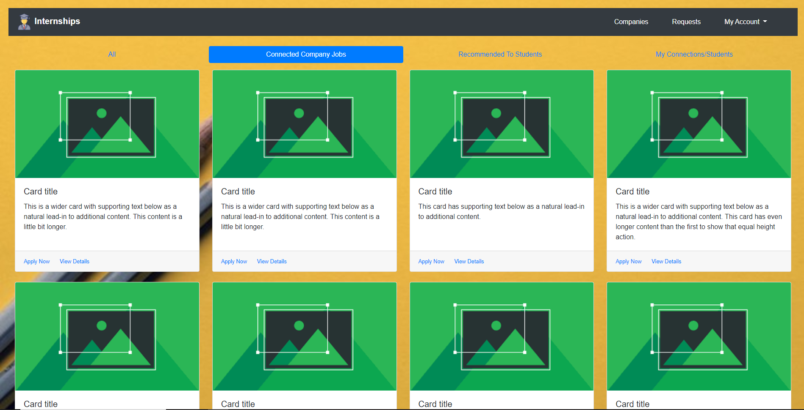
CONNECTED COMPANY JOBS:

Slide 11
BRIEF DESCRIPTION OF COLLEGES/INSTITUTIONS VIEW
*RECOMMENDED TO STUDENTS :A college can apply for any organization for seeking job/internship opportunities for their students by sending requests . All the applied applications and messages will be appeared here.
*CONNECTED COMPANY JOBS : All the jobs posted by our connected companies will be visible here.
*ALL : All the jobs posted by all companies will be vivible here.
*MY CONNECTIONS : All the connections that college/placement officer made with other faculty and students and organizations will be appeared here.
*REQUEST MESSAGES :Any organization or individual can request college to hire students who have required skills.

Slide 12
BRIEF DESCRIPTION OF FACULTY/MENTORS VIEW
*APPLIED APPLICATIONS :A college can apply for any organization for seeking job/internship opportunities for their students by sending requests . All the applied applications and messages will be appeared here.
*POST :A college can make a public announcement in the form of post so that any organization can establish connection with college and provide jobs/internships
*CONNECTIONS : All the connections that faculty/mentor with other faculty and students and organizations will be appeared here.
*REQUEST MESSAGES :Any organization or individual can request college to hire students who have required skills.

Slide 13
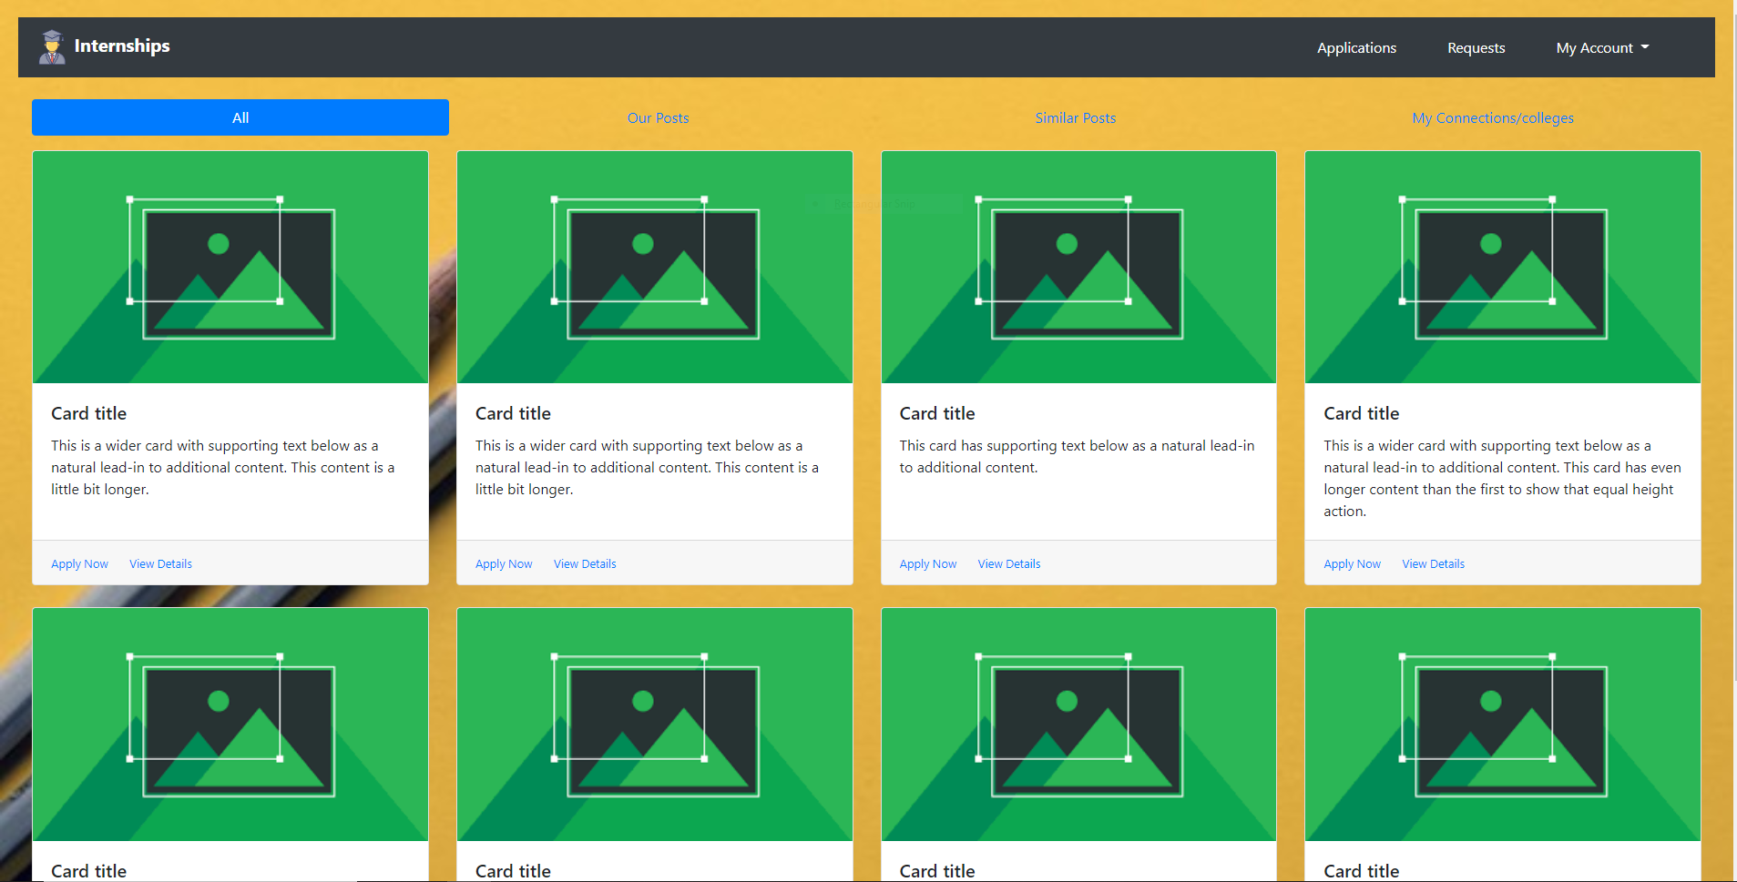
ORGANIZATION VIEW:

Slide 14
APPLICATIONS:

Slide 15
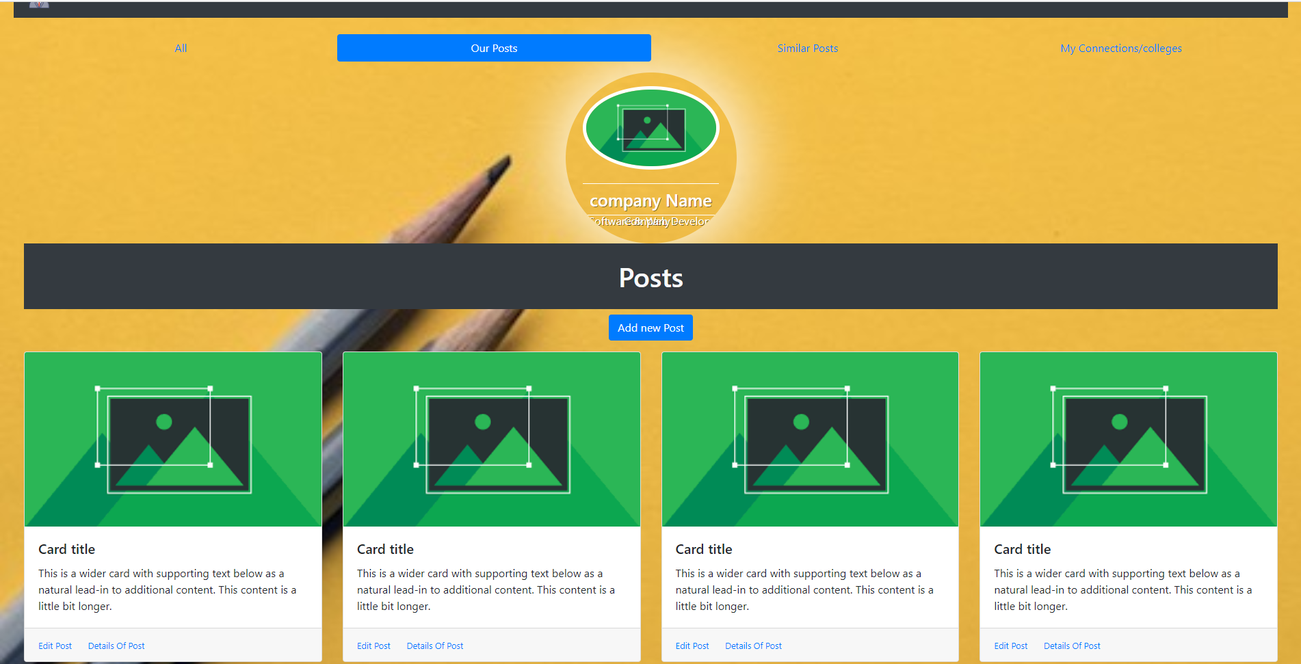
OUR POSTS:

Slide 16
BRIEF DESCRIPTION OF ORGANIZATIONS VIEW
*OUR POSTS: All the jobs/internships posted by the organization will be appeared here organizations can edit details of post.
*SIMILAR POSTS: All similar jobs will be appeared here.
* RECEIVED APPLICATIONS :Applications of the applicants will be appeared here.
* REQUEST-MESSAGES :Applicant can send request to the organization seeking job/internship.All the messages/requests will be appeared here.
* CONNECTIONS :All the connections with colleges and individuals will be appeared here.

Slide 17
OUTCOME
* We will be able to create a platform which establishes a well and user friendly connection between job seekers and job providers.
*Colleges will also make their placement processes very easily
*Individuals can also reach the organizations for jobs in a easy way.
*As placement officer maintains the entire information of college organizations can reach easily

Slide 18
Thank You
-TEAM CREATORS

